Slide 1

Travas
Augmenting cryptocurrency traders with the power of data analysis and automated trading

Slide 2
Problem: Algorithmic Trading is Complicated
Trading algorithmically has historically been expensive and requires immense technical knowledge of programming
This results in large up-front costs of money and time
Cryptocurrency speculators have had no simple bot trading platform

Slide 3
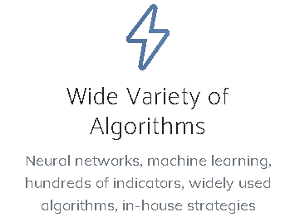
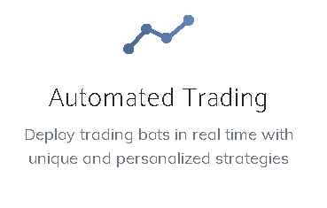

Solution: Travas Platform
A web-based platform for researching and algorithmically trading cryptocurrency

Slide 4
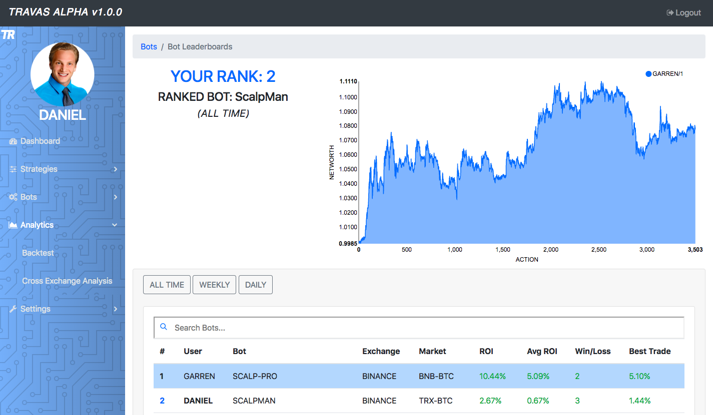
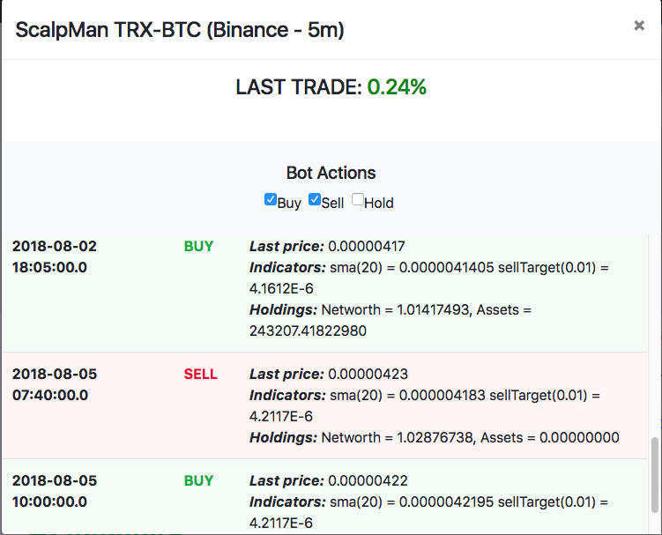
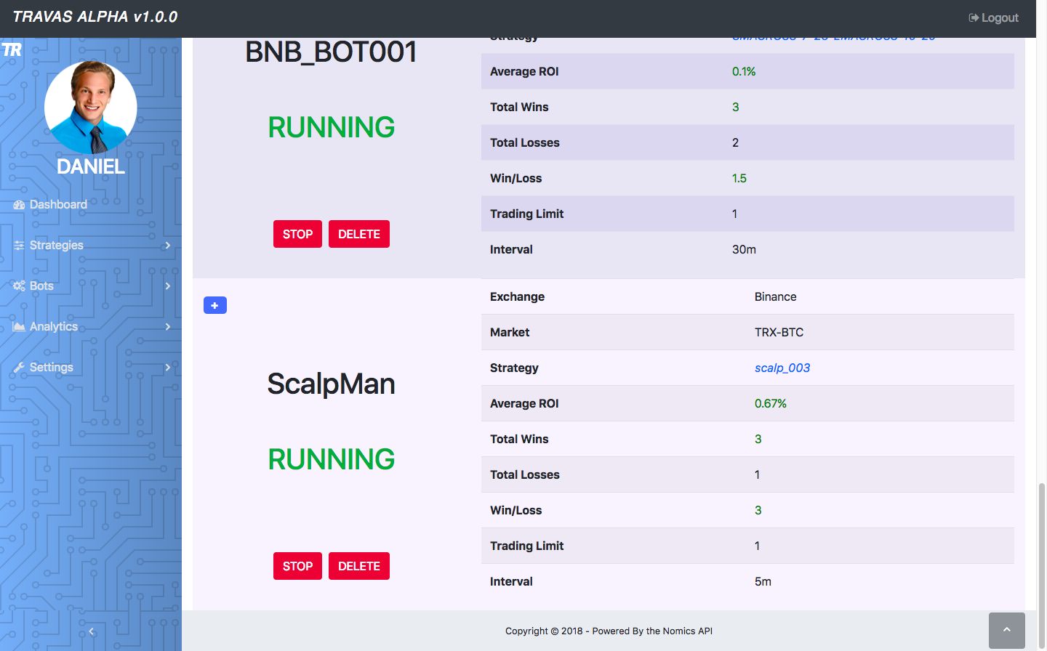
Product - Automated Trading

Slide 5
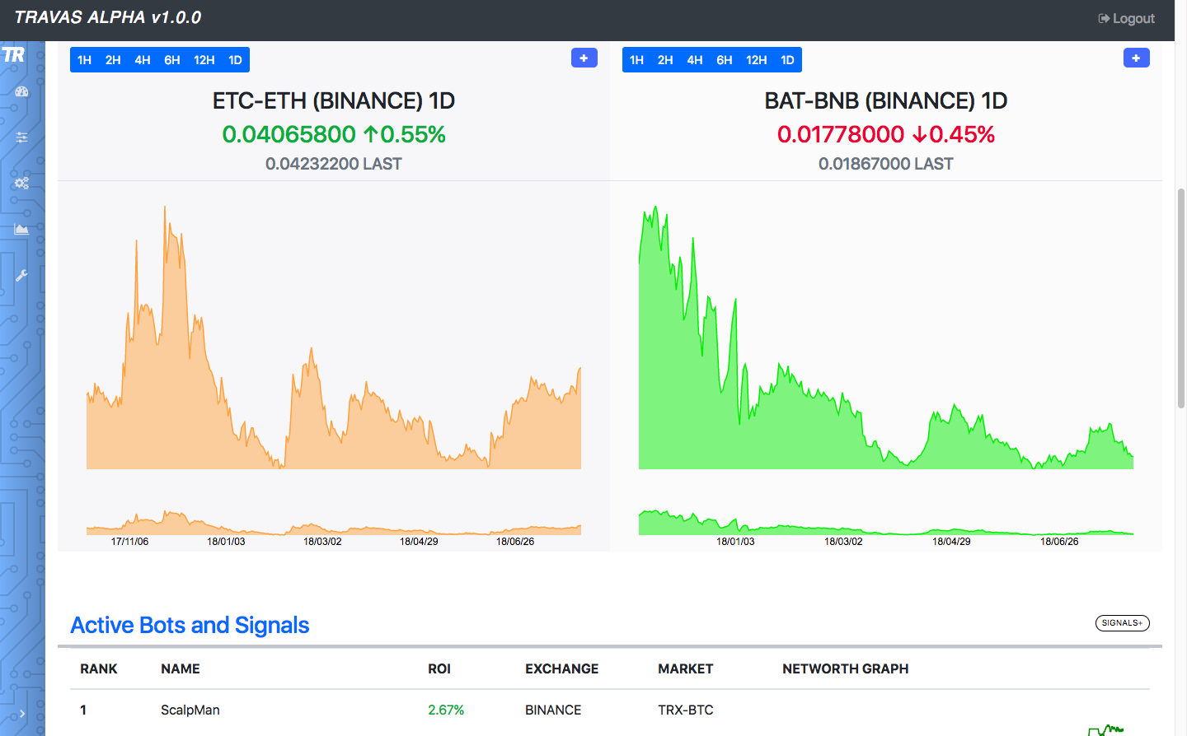
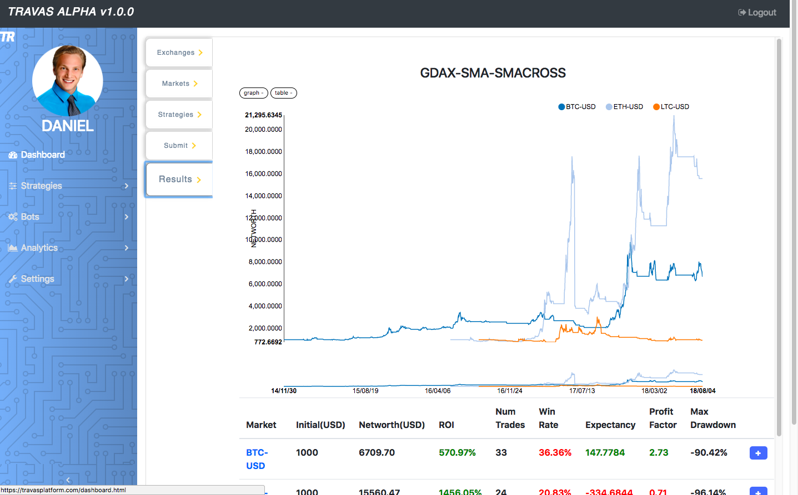
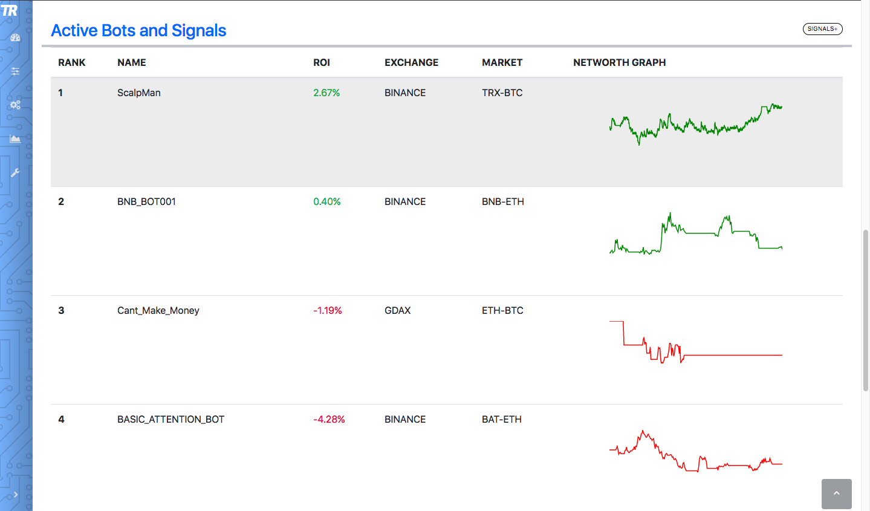
Product - Market & Data Analysis

Slide 6
Why Now?
Relatively untapped market with only a few competitors.
The cryptocurrency market is quickly expanding as cryptocurrency becomes a mainstream technology

Slide 7
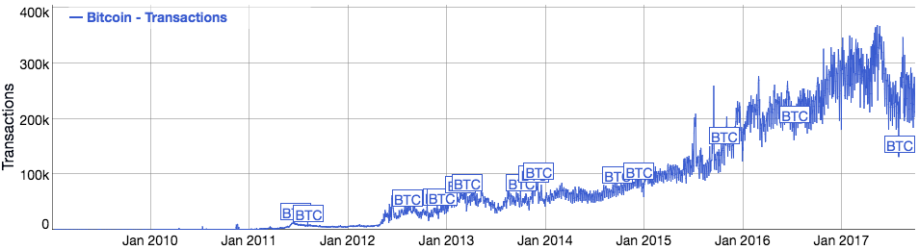
Market
300B +
2900%+
1600+
Cryptocurrency Market Cap
Market Cap increase in 2017
Number of Cryptocurrencies

Slide 8




Competition
Automated Trading | Data Analysis
Peer-to-Peer Investing | Market Education

Slide 9




Team
Daniel Anderson
Co-Founder/CEO
Matthew Teeter
Co-Founder/CFO
Christian Skinner
Co-Founder/Developer
Clay Collins
Advisor (Nomics)

Slide 10
Roadmap
Private Alpha
Public API
Live Trading
Newsletter Launch
Rolling Alpa -> Open Beta
Machine Learning API
Company Branding
Production Launch
V2 Development
Mobile App Development
Q3 2018
Q4 2018
Q1 2019

Slide 11


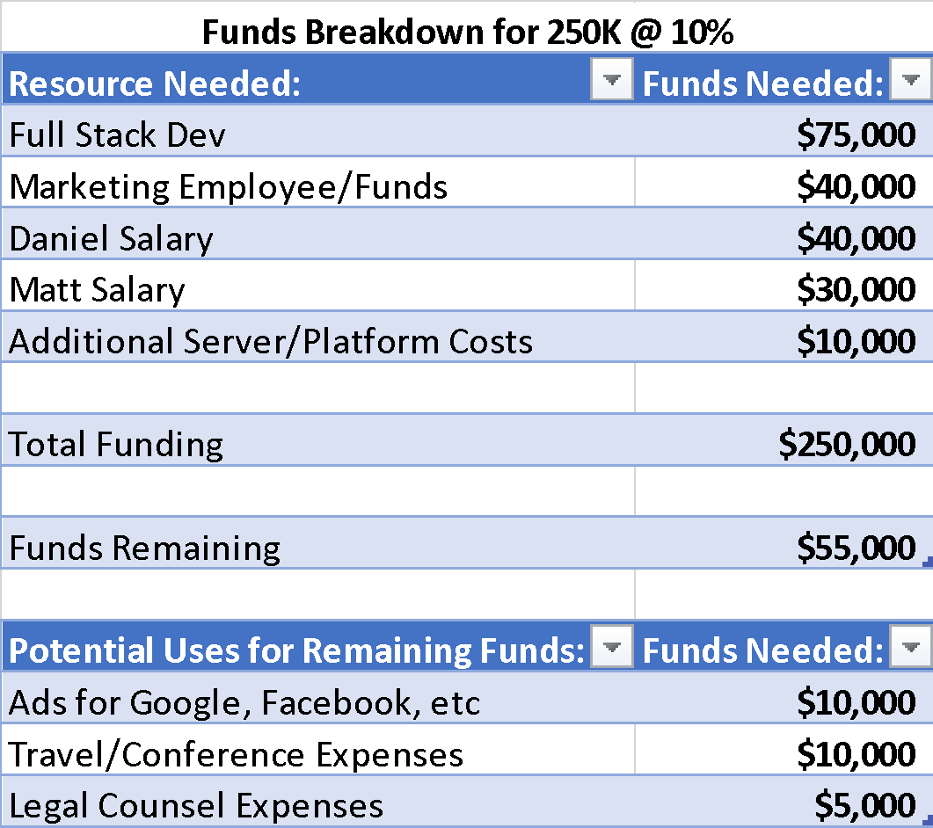



Funds Needed

Slide 12
THANK YOU FOR WATCHING!
Are there any questions?

